Slide 1











Food Planner Application
Group Code:
CAI1_SWD4_G1e

Slide 2






Project Overview
Simplifying meal planning by offering a mobile app that helps users organize and plan their weekly meals.
It allows users to browse, save, and view meal details, even offline.

Slide 3


Key Features
User Authentication
Meal of the Day
Meal Search
Favorite
Meals
Meal Planning
Meal Categories
Guest Mode
Offline Access

Slide 4

User Authentication AND
Guest Mode
User Authentication:
Provides user login/signup options using Firebase Authentication.
Guest Mode:
Allows users to explore meal categories and daily suggestions without requiring an accounts

Slide 5




Meal of the Day
AND
Meal Categories
Meal of the Day:
Displays a random meal suggestion each day to inspire users.
Meal Categories:
Users can view meals categorized by type, country, or ingredient.

Slide 6

Meal Search
Allows users to search for meals based on various filters like country, ingredient, or category.

Slide 7


Favorite
Meals
Users can add and remove meals from their favorite list, stored locally.

Slide 8


Meal Planning
Enables users to add meals to their weekly meal plans for better organization.

Slide 9
Offline Access
Saved favorite meals are accessible even when there’s no internet connection, thanks to local storage using Room database.

Slide 10





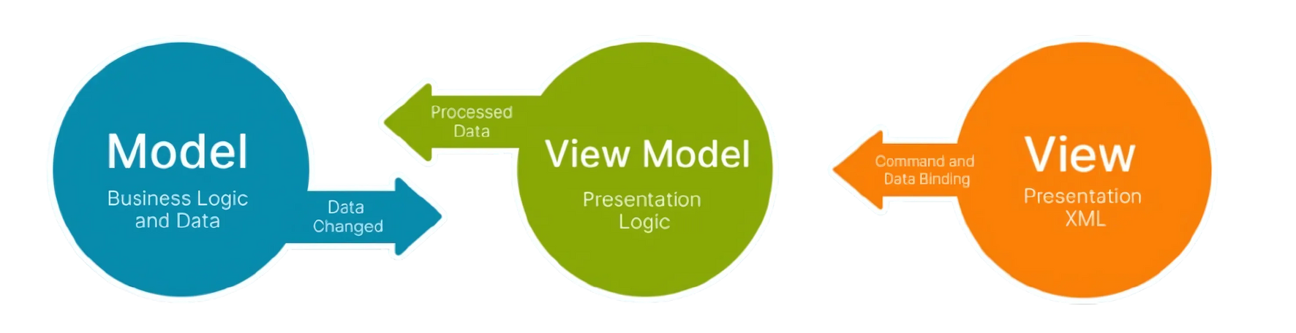
Retrofit
Room Database
Technologies and Tools
Firebase Authentication

Slide 11
Technologies and Tools
1
Android Studio: The main IDE for coding and debugging the application.
2
Firebase Authentication: Handles user login and registration, including social logins like Google.
Room Database: Manages local data storage, enabling offline access to favorite meals.
3
4
Retrofit: For network requests to fetch meal data from APIs.
5
MVVM: Improves modularity and testability by separating UI from business logic.

Slide 12

Thank you

